Slide 1
AI Lab Fundamentals
By Ahmed Qarqaz

Slide 2
Overview
Introduction to Notebooks.
A quick word about packages and libraries.
Paths and Directory (for reading from/writing to storage)

Slide 3
Introduction to Notebooks
By Ahmed Qarqaz

Slide 4
Introduction to Notebooks
Interactive Programming.
Code execution is fully controlled by the programmer.
This is good for prototyping, experimentation, debugging and data analysis.
Ability to write markdown cells for a more customizable documentation.
Allows us to structure our code and divide it to sections.
Markdown cells can be used as headlines for sections.
sections are usually shown in a “table of contents” sidebar.
Python notebooks are stored as the file type “.ipynb”

Slide 5
Notebooks vs Scripts
In scripts, code lines are all executed once the script is running.
In notebooks, code lines/blocks can be segmented into code cells and the programmer executes each cell interactively

Slide 6
How are code blocks executed?
Notebooks load a Python-Interpreter based on the version of Python into memory and calls it the “kernel”.
the notebook uses the interpreter to execute every code cell.
NOTE: It is important that the kernel stays in memory to allow for execution.
Variables and data are live stored in the memory.
Once defined, the data will have a place in memory and can be accessed throughout the notebook.
Can be thought of as “global variables”.
please note this is not an accurate description and global variables are a different concept.

Slide 7
What about markdown cells ?
We can think of Markdown cells as cells meant for comments and documentation.
Used to annotate our notebooks and enhance the readability of our notebooks.

Slide 8
How to close our notebooks ?
Jupyter notebooks are closed and stop execution when the kernel is no longer in memory.
We can “restart” our notebook when something goes wrong.
this frees up all memory that is allocated by our notebook.
code cells will need to be executed again.

Slide 9
Python packages

Slide 10
Installing Packages
Python comes with many built-in packages that are essential and useful
However, many packages that are needed for our work don’t necessarily come pre-installed.
The main and most popular method of installing python packages is by using pip.
pip is usually used on the terminal of the OS (CLI on windows, terminal on Unix-based systems).

Slide 11
Installing Packages
to install a package, we use the command:
pip install package_name
We can also add an optional parameter to indicate the specific version of the package we want to install using the `==` operator:
pip install package_name==1.2.3

Slide 12
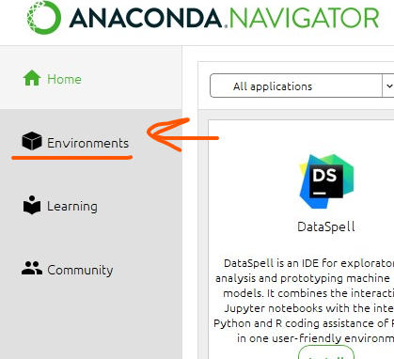
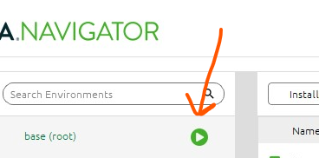
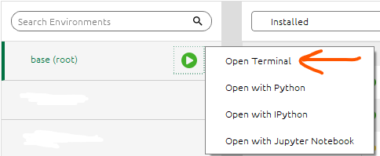
Installing Packages
Two main ways to use pip:
We can use pip in the terminal anaconda provides
go to environments → press the play button → select “open terminal”
We can use pip as a code segment in jupyter notebook by utilizing magic commands in jupyter notebook.
Magic commands are commands that mimic (act like) Unix-based terminal commands.

Slide 13
Package Version Control
Version control is usually not a problem.
However, in some cases it is important that the programmer is aware of the versions of the packages they are using.
Packages evolve and change overtime.
some changes may impact how your code executes and raise some errors.

Slide 14
Paths and Directories
and a brief look at Unix commands.
Slides are from the book:
“Linux Essentials for Cybersecurity - Pearson IT Certification.”

Slide 15
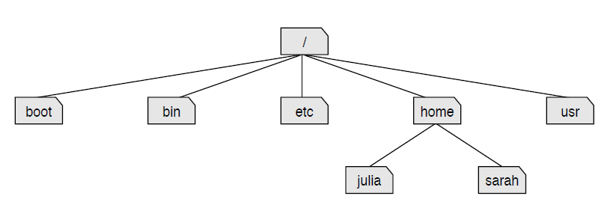
File Management
Every storage location is accessible under the top-level directory (root)
The root directory is symbolized by /

Slide 16
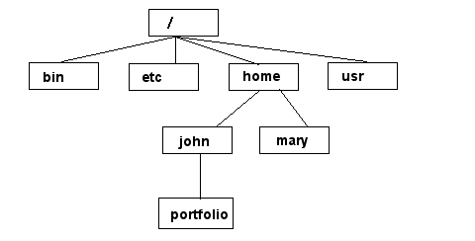
Unix/Linux File System
© 2019 by Pearson Education, Inc. Chapter 2 Working on the Command Line
NOTE: Unix file names
are CASE SENSITIVE!
If you are here:
Relative Path
/home/mary/
../mary/
./portfolio/
/home/john/portfolio/
Absolute Path

Slide 17
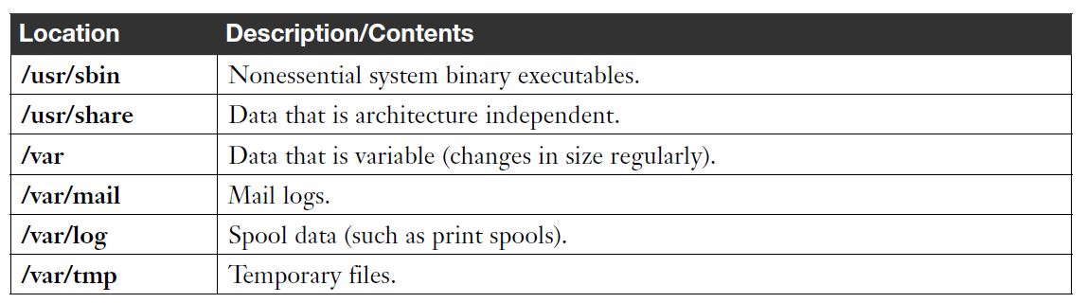
Filesystem Hierarchy Standard (cont.)
/
tmp
dev
etc
home
usr
chris
mary
lib
include
bin
local
lib
include
bin

Slide 18
Intro to Unix: Essential Commands
© 2019 by Pearson Education, Inc. Chapter 2 Working on the Command Line
cd - change directory - cd
mkdir - make a directory - md
cp - copy a file - copy
ls - list files - dir
rm - remove a file - del
mv - move a file - move & ren
grep - expression searching
top - cpu and memory usage
who/w - who else is logged in
man - read documentation
• where am I?
– pwd
• who is around?
– who
• where is that file?
– find <path> -name <name>

